Slide 1
FTS Real Time: Python Socket API
What is it:
  Real time connection between your Python script and the Real Time FTS Client (FTSRT)
    Receive data updates from FTSRT at a frequency you specify
    Save data, merge with external data sources, submit trade orders
How does it work:
  Login to FTSRT
  Initialize the API
  Launch your Python script
    Our samples show you how to connect to FTSRT

Slide 2
Launch FTSRT
Initialize API
Launch Python and run script
Send basic information
Select case, login
Create trades
Send trades
Receive data from FTSRT

Slide 3
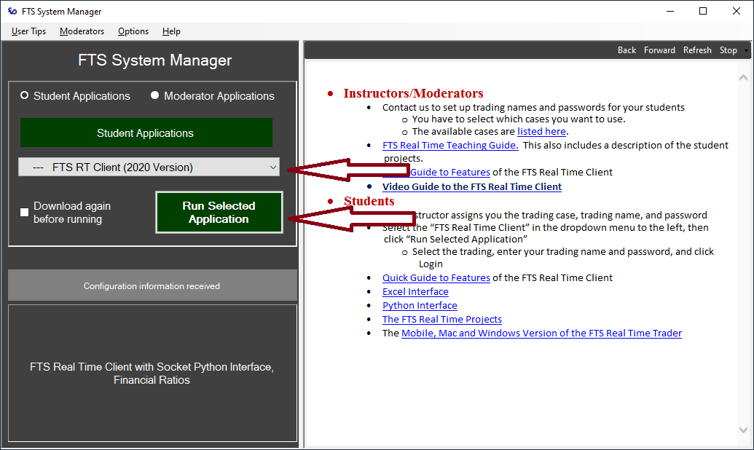
Launch FTSRT: from the FTS System manager

Slide 4
Login to RTFTS
Select your trading case
Enter trading name, password
Login

Slide 5
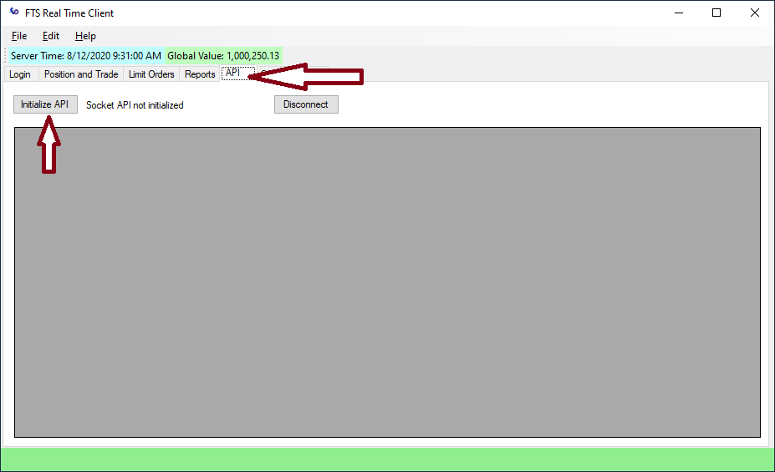
Initialize API from the API tab

Slide 6
Launch your python script
Run Python and launch your script
The script must have the socket connection as demonstrated in this sample file
http://www.ftsmodules.com//public/modules/ftsRT/RT2020/Scripts/ConstantMix_RTSocket.py.txt
To start, just run the sample file and you will see how it works

Slide 7
The sample PY script
This has several parts and functions defined
  Keep the script exactly as is, the only thing you should replace is the constant_mix function and where it is called in the “while True” part at the bottom
  The comments explain how the strategy works
How it works:
  When you launch the script, it connects FTSRT through a socket
  The script then sends the tickers and the frequency at which you will receive updates

Slide 8
The PY File
Create trades
Send trades
Receive data from FTS RT
It then loops:
  Receive data from the FTS RT Client
  Construct the trading strategy
  Send the trades

Slide 9
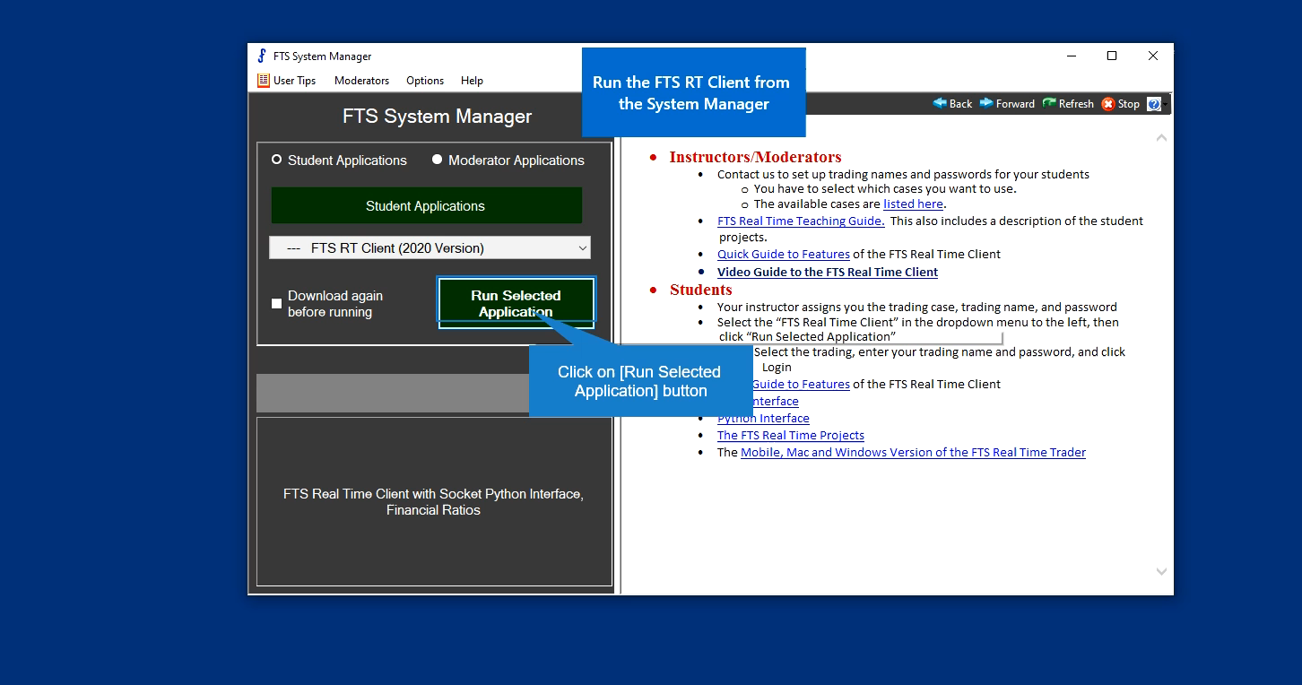
Video showing the steps with the sample script
http://www.ftsmodules.com//public/modules/ftsRT/RT2020/Scripts/ftsRTPython.mp4

